Slide 1

Task Analysis
Sami Durrani PhD and Eric Bergman PhD
Notes:
Quick introductions

Slide 2
Types of task analysis
There are many different forms of task analysis
Hierarchical Task Analysis (HTA)
Cognitive Task Analysis (CTA)
And many more variations and modifications
In medical device human factors, a “task analysis” is typically a modified HTA
Notes:
Hierarchical Task Analysis (HTA): HTA is one of the most widely used methods. It breaks down complex tasks into a hierarchical structure, showing the relationships between higher-level goals and lower-level sub-tasks. HTA is often used to design and evaluate user interfaces and to identify potential usability issues.
Cognitive Task Analysis (CTA): CTA focuses on understanding the cognitive processes, strategies, and decision-making involved in completing a task. It is particularly useful in complex domains such as aviation, healthcare, and military operations. Techniques like think-aloud protocols, cognitive interviews, and knowledge elicitation are employed in CTA.
Event-Based Task Analysis: Event-based analysis focuses on specific events or incidents within a task. It is useful for understanding how users respond to unexpected situations and how system design can support effective responses

Slide 3
Key steps in conducting a task analysis
Identify task
Decompose task into sub-tasks (if needed)
List use-steps (if known and if needed)
Identify potential use-errors
Use PCA to help identify potential causes and potential use errors

Slide 4
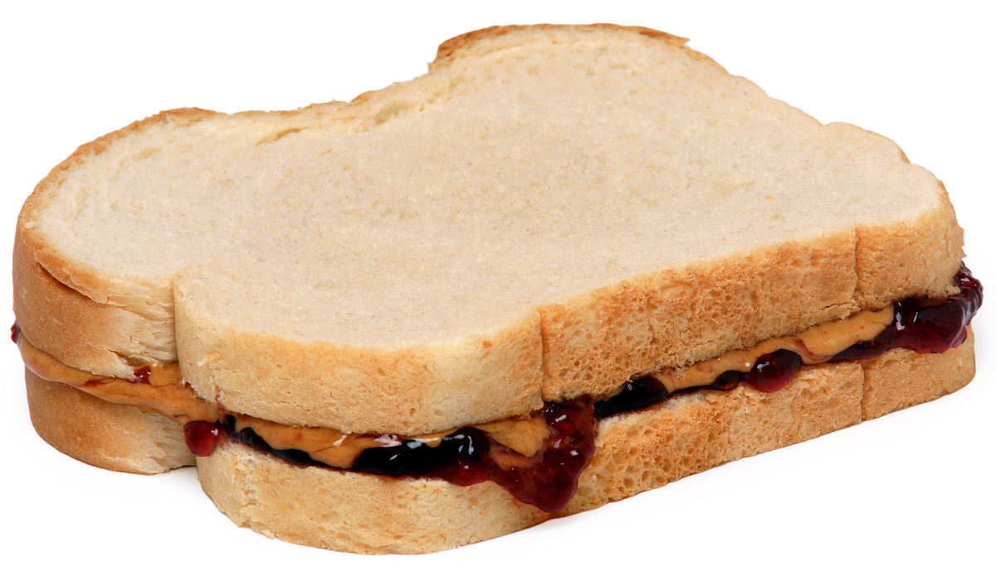
Simple Example: Peanut Butter & Jelly

Slide 5

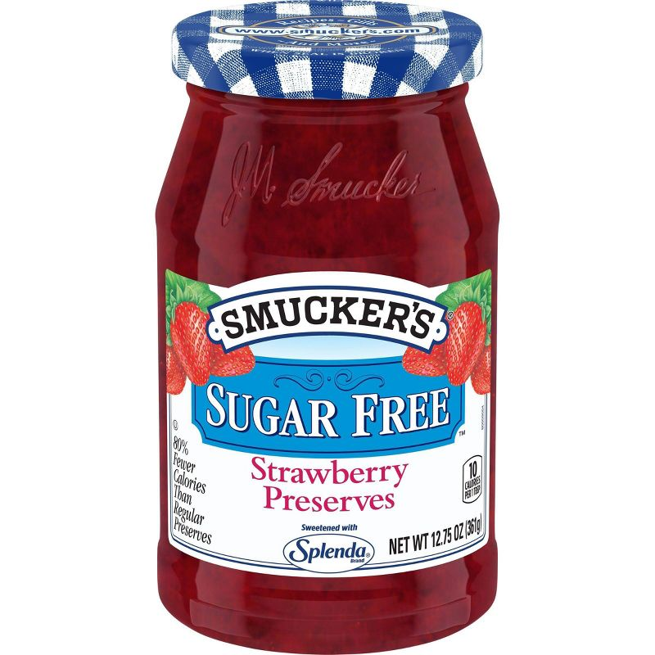

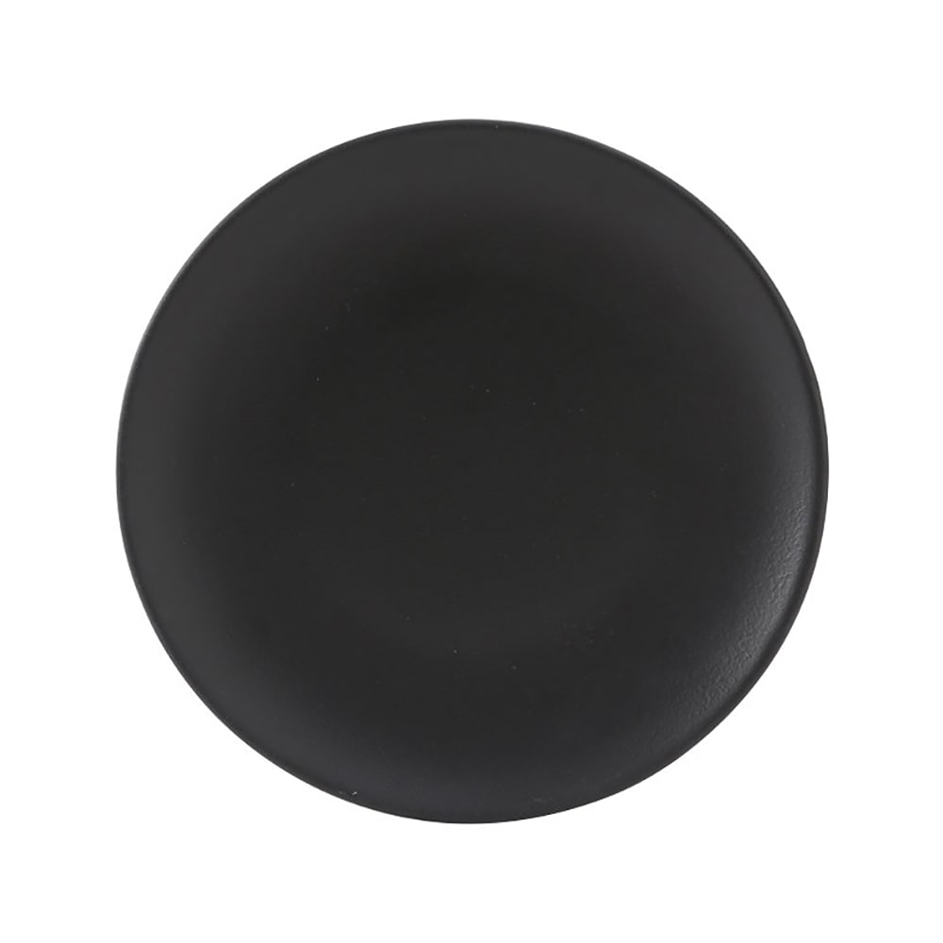
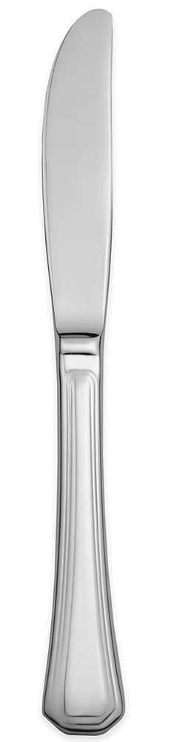
PB&J
Task 1: Gather supplies
BUT WAIT!
We forgot to wash our hands!
We also forgot to make sure the ingredients aren’t expired!
Task 2: Prepare bread
Use steps:
Remove bag slip
Open bag
Grasp end piece
Move it out of the way
Grasp next two pieces
Take them out of bag
Place bread slices on plate, side-by-side
Notes:
Key note, task analysis are hard, time consuming and require many iterations.
OK, let’s assume that we went back and did the correction. Added in those key steps. Let’s keep on going.

Slide 6
PBJ
Task 3: Spread peanut butter on slice 1
Task 4: Spread jam on slice 2
Task 5: Combine slices together
Task 6: Cut sandwich diagonally (optional)
Task 7: Eat
Task 8: Clean up and store supplies
Notes:
Oh man, I’m not even hungry even more. This simple example is isn’t as simple as I thought. To move us along, I am going to skip writing the use steps and talk about them.
Two knives to avoid “contaminating” jar?

Slide 7
Let’s do a quick task analysis: Autoinjector

Slide 8
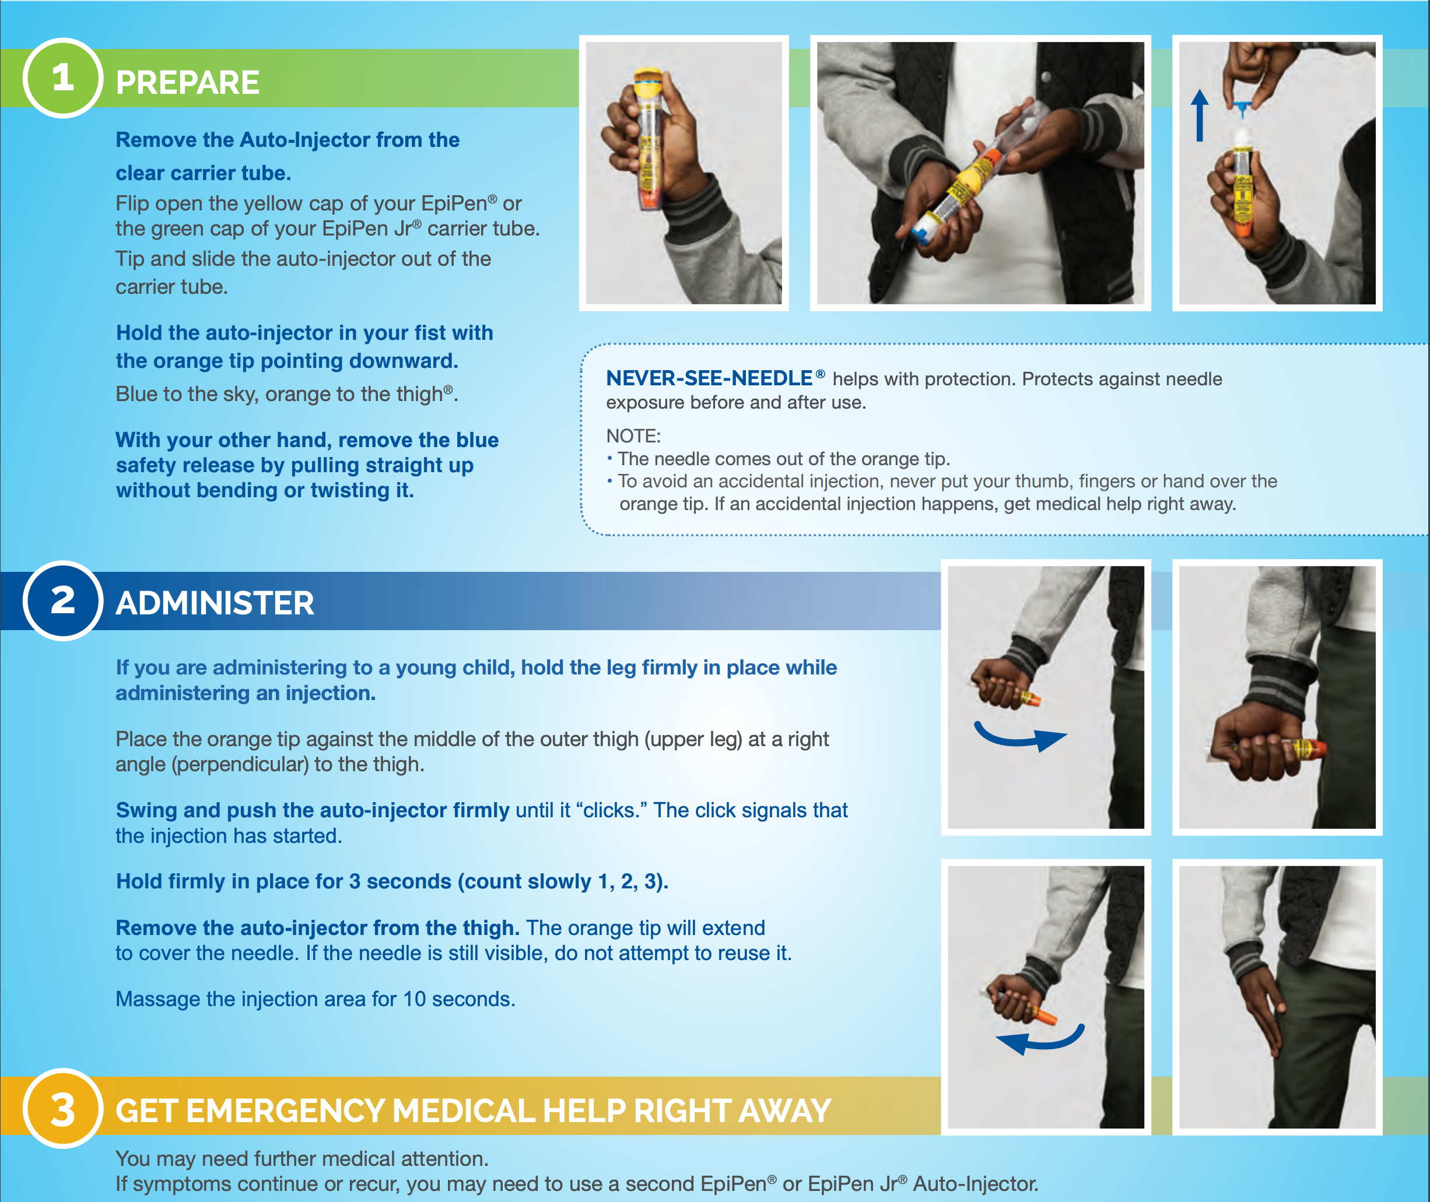
Autoinjector analysis continued…

Slide 9
But what if you don’t have a design yet?
Define preliminary tasks and use steps
OK to make assumptions early on
Develop cognitive walkthrough and design sketches/mock-ups
Do a preliminary hazard analysis (PHA)
Key concept:
Don’t need a device design to start identifying potential use errors
Notes:
Task analysis can be done even before a concrete design is available. At early stages, it's based on the intended use and functionality of the device or system rather than its specific design features.
There’s several ways you can approach doing an early stage task analysis. And its important to know that the task analysis will grow as the team designs and develops the design.

Slide 10
PHA Example: Infusion Pump
Hazard | Potential Causes* *note: not UEs yet | Potential Consequences
Drug over-infusion | User data entry error User does not understand amount programmed | Overdose
Battery dies mid-treatment | User does not recharge battery User does not know battery state | Underdose
Contamination at infusion site | User does not use sterile components | Infection

